Slide 1
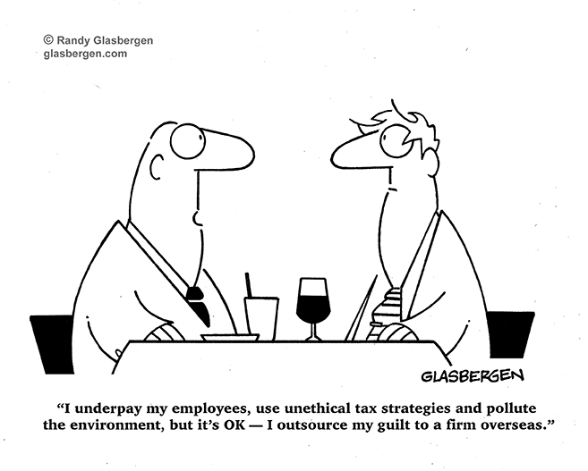
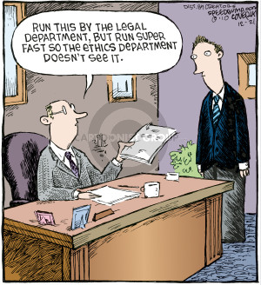
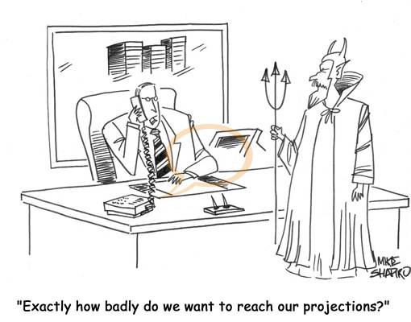
Business Ethics in a Global Economy

Slide 2
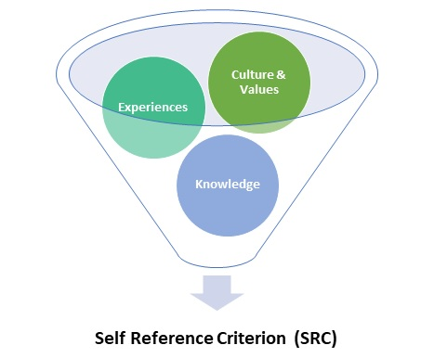
Self-Reference Criterion...
unconscious reference to one’s own cultural values, experience, & knowledge
a reaction based on knowledge grounded in our cultural heritage & accumulated over a lifetime
may not have the same relevance to people of other cultures

Slide 3
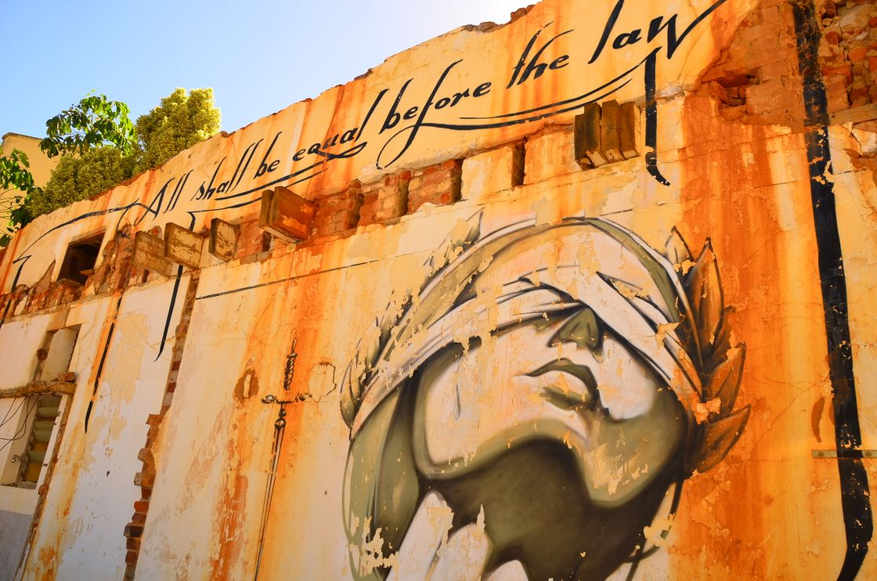
Perceptions of Corruptness...
Least Corrupt:
  New Zealand
  Denmark
  Finland
  Sweden
  Switzerland
  Singapore
  Norway
  Netherlands
  Luxembourg
  Germany
Most Corrupt:
  Somalia
  South Sudan
  Syria
  Yemen
  Sudan
  Afghanistan
  Venezuela
  North Korea
  Libya
  Guinea-Bissau

Slide 4
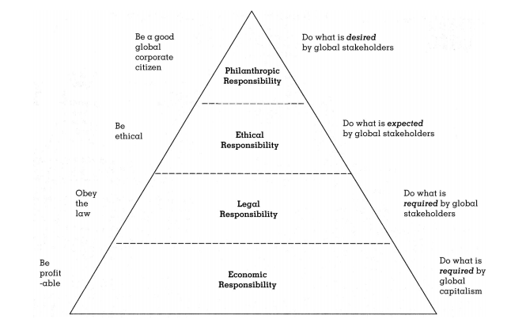
Global Ethical Issues...
discrimination
human rights
price discrimination
bribery
harmful products
pollution
telecommunications issues

Slide 5
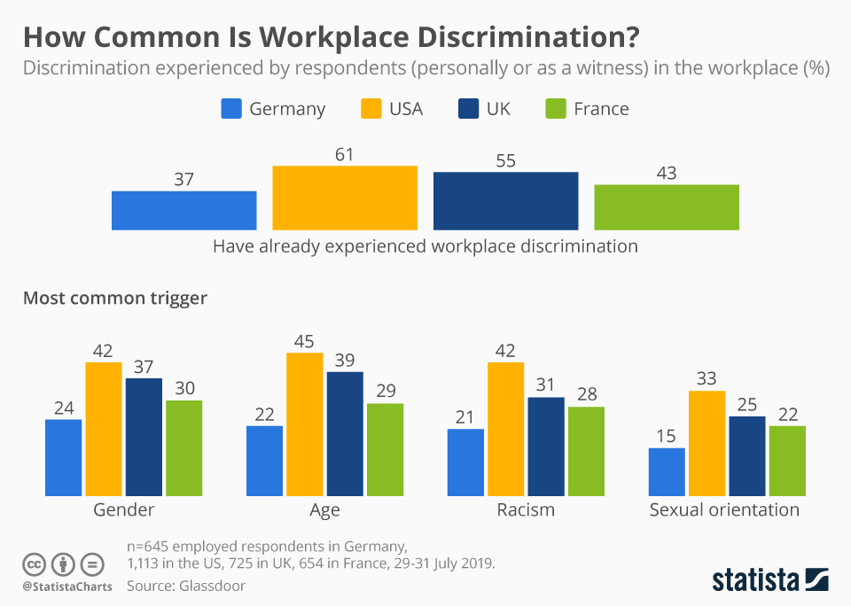
Discrimination...
U.K. law prohibits British businesses from discriminating on the basis of sex, race, religion, or disabilities in their hiring, firing, & promotion decisions
globally, discrimination is culturally embedded in many countries/regions

Slide 6

Human Rights...
concern for the well-being of employees; key concerns are use of child labor, payment of low wages, & abuses in foreign factories
multinational corporations should view the law as the floor of acceptable behavior and strive to improve workers’ quality of life

Slide 7
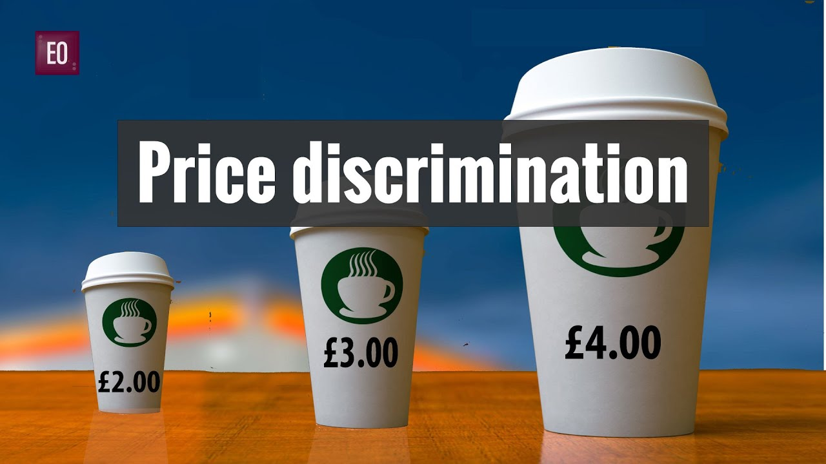
Price Discrimination...
occurs when a firm charges different prices to different groups of customers (these differences are legal if they do not reduce competition, or can be justified on the basis of cost)
  gouging is when unusually high prices are charged due to a shortage
  dumping involves charging high prices for a product at home and low prices in foreign markets

Slide 8

Bribery...
facilitating payments are acceptable in many cultures
U.S. law addresses this issue with the Foreign Corrupt Practices Act:
  prohibits American corporations from offering or providing payments to officials of foreign governments to obtain or retain business abroad

Slide 9
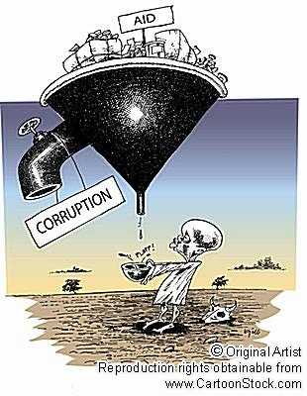
Causes of Bribery...
matching competitor’s bribes
lack of monitoring and training
organisational pressure to meet sales quotas
belief that bribery is a cost of doing business
perception that bribery is acceptable
vendor pressures for bribery
political involvement in decision making
showing appreciation
gaining entrance in to new markets
displacing major competitors

Slide 10
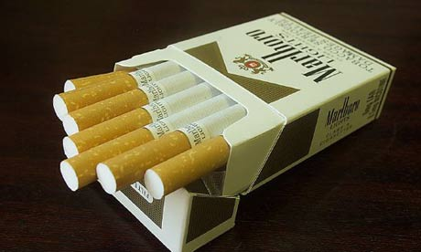
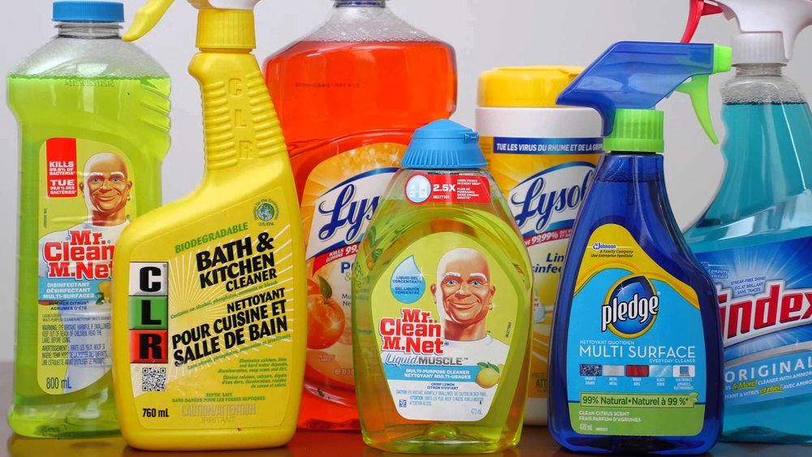
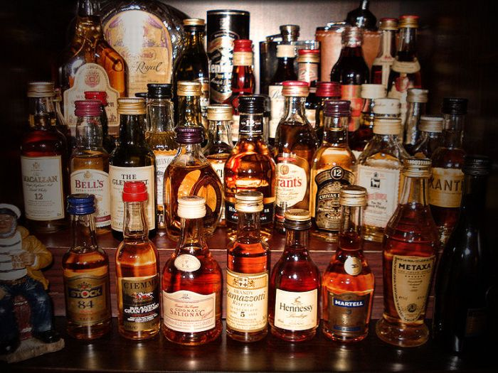
Harmful Products...
issues surrounding pesticides, tobacco products, dumping of waste materials, illiteracy, unsanitary conditions, & cultural values

Slide 11
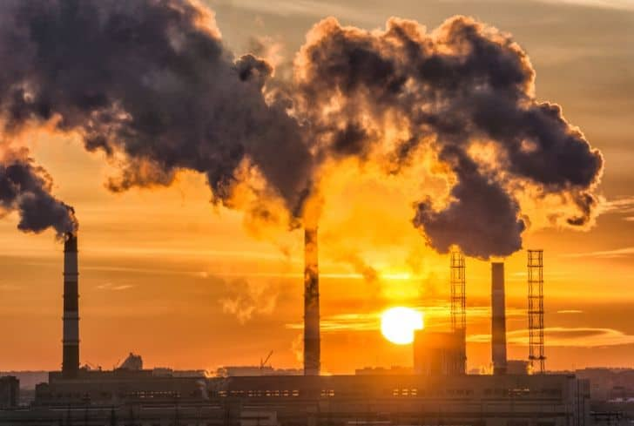
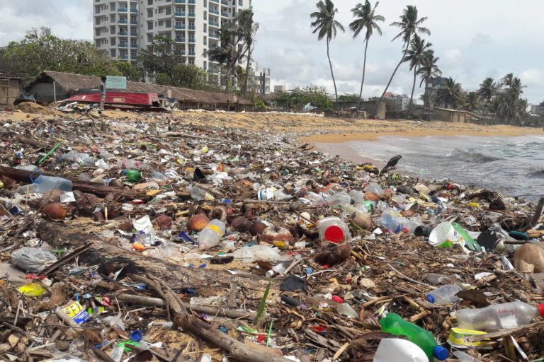
Pollution...
there are no physical boundaries on the extent of the damage resulting from environmental abuse
key concern areas:
  carbon dioxide (greenhouse gas)
  methane gases
  overall water & air quality

Slide 12



Telecommunications Issues...
violations of copyright laws
advertising

